Slide 1


MAHARASHTRA STATE BOARD OF TECHNICAL EDUCATION
GOVERNMENT POLTYTECHNIC JINTUR
COMPUTER ENGINEERING DEPARTMENT
ACADMIC YEAR:- 2025-2026
Gauri Dahale
Vaishnavi Gaikwad
Amruta Khodse
Rupali Pofle
PRESENTED BY:
TOPIC :- CPP Final Project: E-commerce Business Web Application
UNDER GUIDENCE OF :-PROF. M.A.ZAHED SIR

Slide 2

M-tech Multi-services Web Application
Project Name: M-Tech Services
Subtitle: A Secure & Innovative Digital Platform

Slide 3
"Introduction to M-Tech Services"
Brief Overview of M-Tech Services (Project Overview)
M-Tech Services is a comprehensive digital platform designed to provide ID card solutions, IT services, and security systems. The platform ensures efficiency, security, and seamless user experience by Providing cutting-edge technologies such as biometric authentication, encryption, and e-commerce functionalities.
Services of the Project:
ID Card Solutions: Custom ID cards, smart cards, and RFID-based authentication.
IT Services: Networking solutions, software support, and technical consulting.
Security Systems: Biometric authentication, surveillance cameras, and access control.
Government Document Service: Proved quick and easy steps to fill any government documents.

Slide 4
System Functionality – What the System Does
The M-Tech Services System is designed to provide a secure and efficient platform for managing
ID card processing, biometric authentication, and security device integration.
System Functionalities:
Placing orders
Tracking Orders
Provide Important Information
Data Handling
Data modification
Instant Problem Resolve

Slide 5
Technologies Uesed:
Development Language:
Frontend Languages: HTML, CSS , JAVASCRIPT
Backend Languages: PHP, MYSQL
Resources Used: Vs Code Code Editer, Xampp Server application, Google Chrome Browser

Slide 6
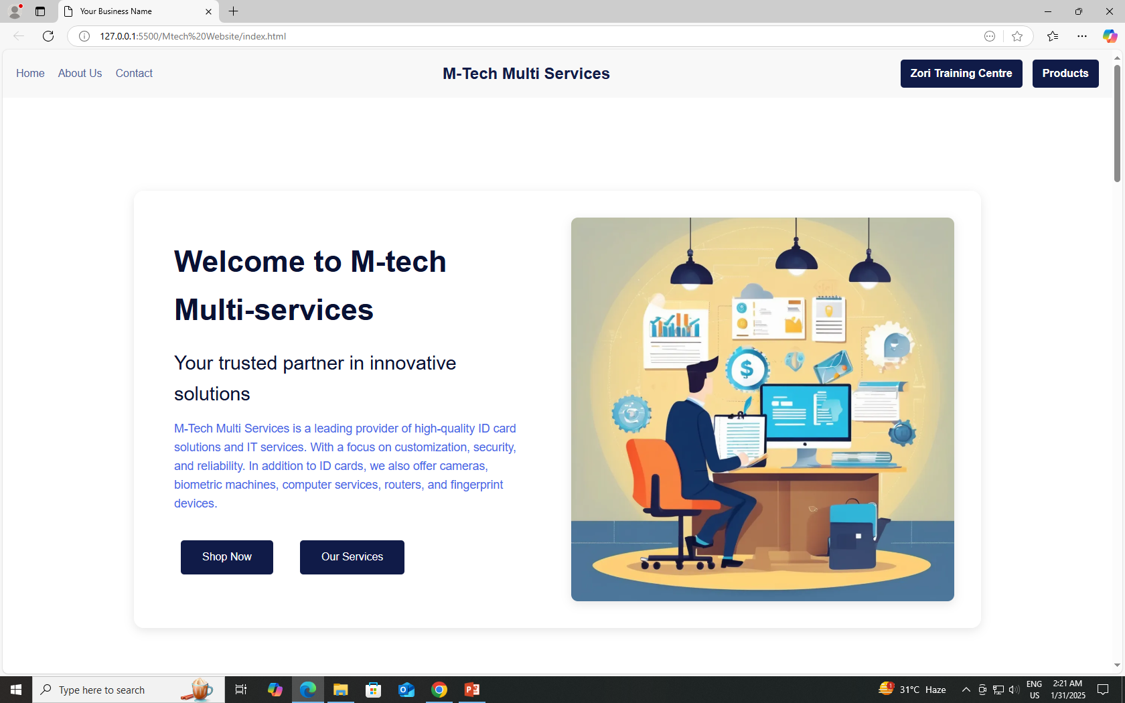
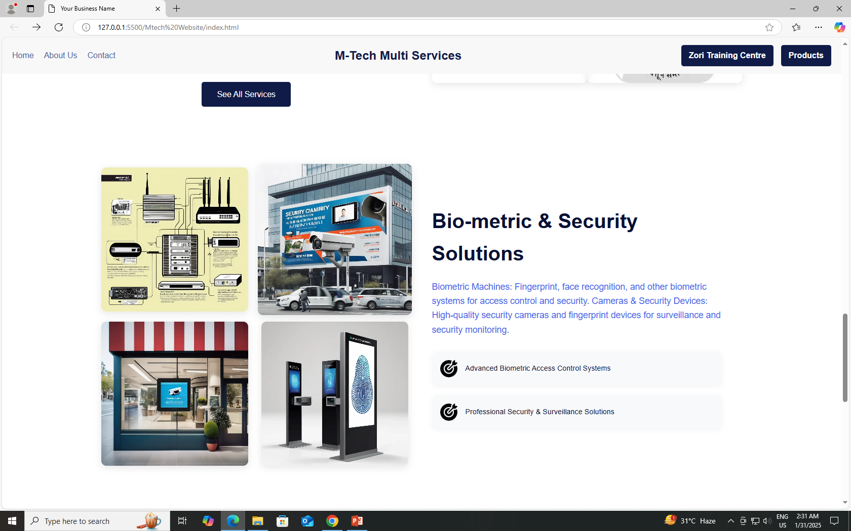
Output

Slide 7
Conclusion
M-Tech Multi-Services has successfully developed an efficient web application that enhances customer experience through a user-friendly front end and a well-integrated back-end system. The seamless interaction between these components ensures smooth transactions, secure data handling, and effective inventory management.

Slide 8
References
Link: https://chatgpt.com
Dialogflow (by Google)
Link: https://dialogflow.cloud.google.com/
Rasa
Link: https://rasa.com/
Botpress
Link: https://botpress.com/

Slide 9

Thank You!!

